Slide 1
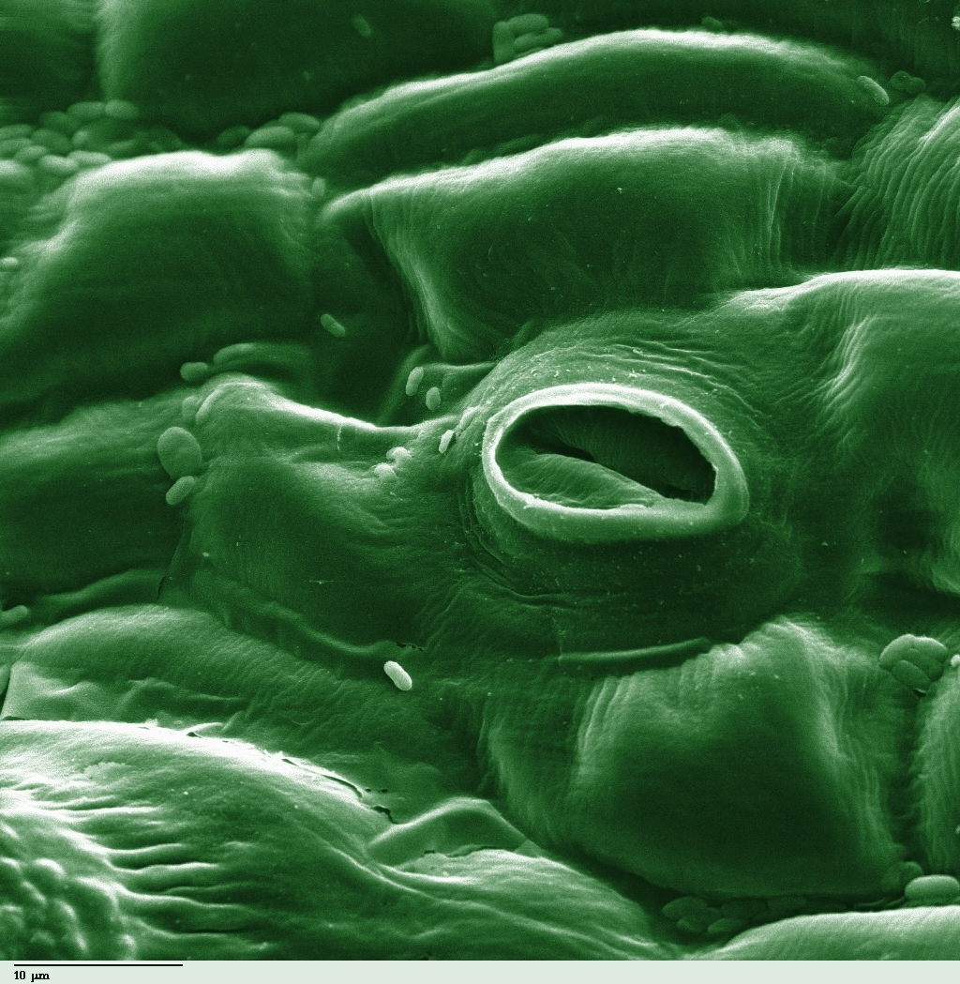
Transpiration Investigation

Slide 2
Directions: “Celery Model Lab”
Design an experiment to test Transpiration using the supplies at your table:
Colored water in beaker
Celery
Record in IYB “Celery Model Lab”

Slide 3
Questions
Analyze how transpiration relates to the flow of H₂O through the celery’s xylem.
Evaluate how the properties of water assist in water flowing through xylem.
OYO (on your own) Synthesize one question pertaining to the lesson ☺

Slide 4
Careers in Botany
http://www.ou.edu/cas/botany-micro/wcidwmib.html

Slide 5
Self Assessment: Answer the following on a sheet of loose leaf
Topic: Transpiration
Predict we will learn next? Explain.
How would you create/design an activity to help you understand today’s objective?
REVISE the most confusing section of your notes or thoughts from today.
FORMULATE a plan or find an unusual way to study/remember today’s lesson.

Slide 6
“Plant Graphs”
Read and follow instructions
You will be creating graphs and justifying the effects of temperature on transpiration rate
Answer multiple choice questions based on data and justify these answers
An aspiring botanist claims that increasing leaf surface area, wind, and humidity will increase the rate of transpiration from the leaf surface. Analyze the error in his claim, and justify your explanation with scientific concepts.

