Slide 1
DNA Replication

Slide 2
If a cell is going to replicate, it needs….?
Students: Make a list to answer the question above.
Compare and contrast your list your tablemates
Compile a class list and/or make a class chart

Slide 3
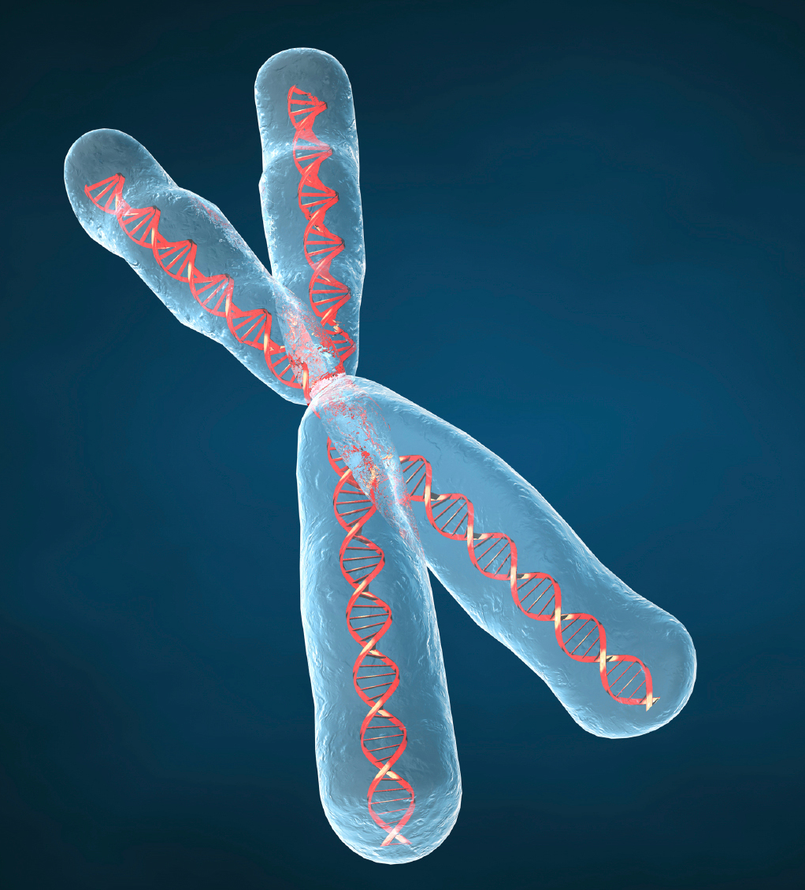
Chromosomes
Compact DNA in “X” shape
Why an X?

Slide 4
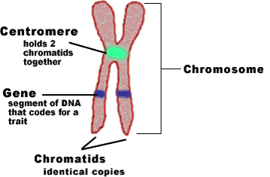
Chromosome structure

Slide 5
Define
Gene: specific sequence of DNA that codes for a trait
Trait: physical characteristic
Ex: blonde hair, tall, dimples

Slide 6
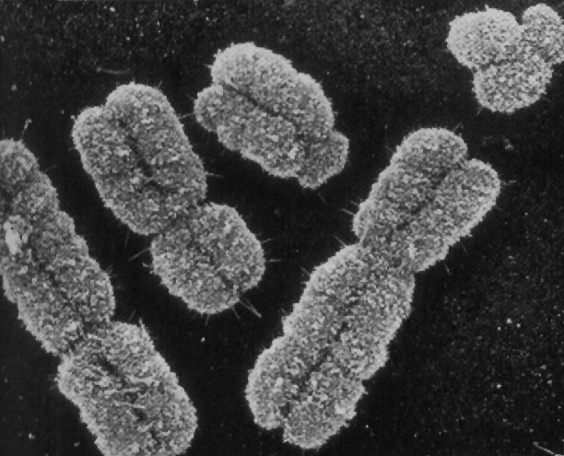
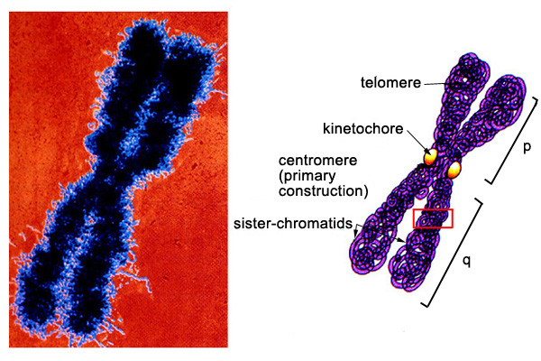

Slide 7
Student Activity
Build a chromosome using the play dough in your baskets
Quiz one another on the parts of the chromosome

Slide 8
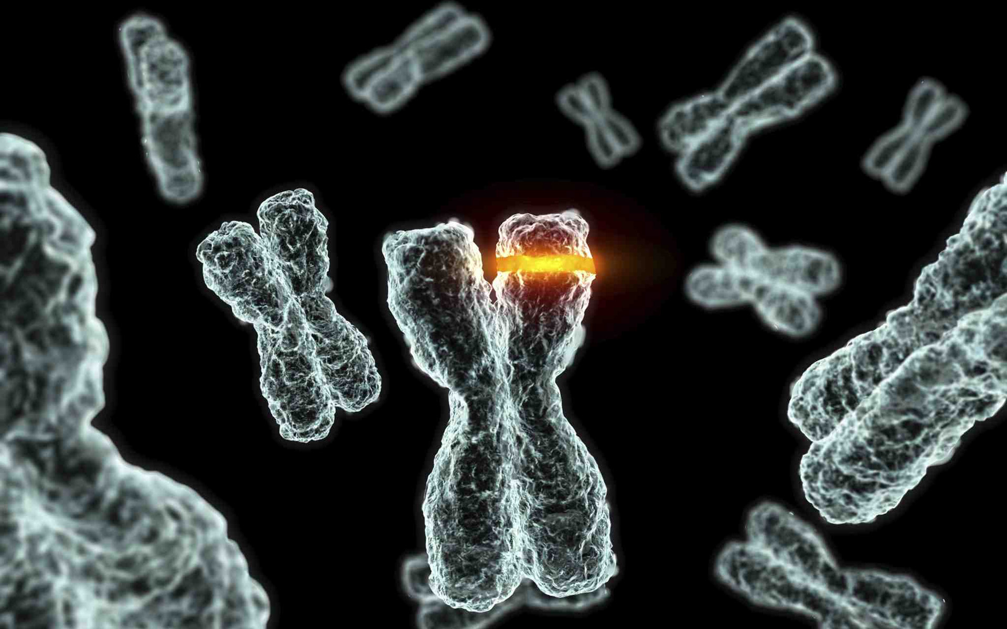
Critique this picture ☺

Slide 9
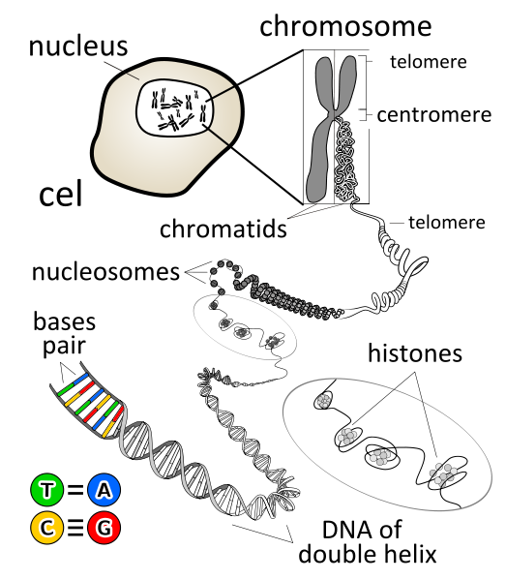

Slide 10
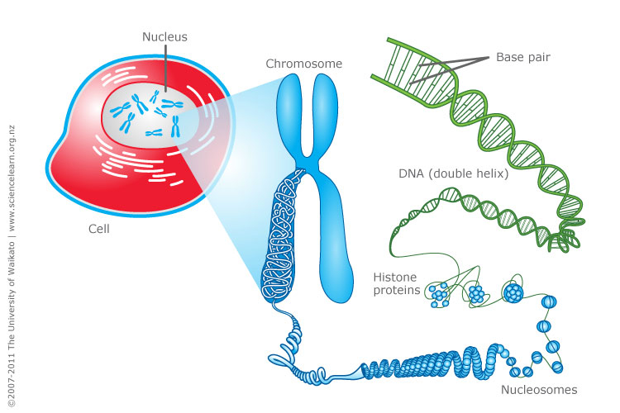

Slide 11
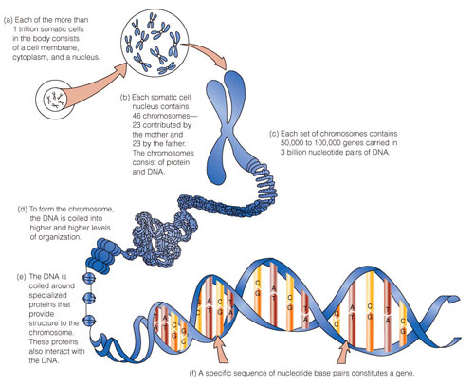

Slide 12
Chromosome structure
http://www.youtube.com/watch?v=gbSIBhFwQ4s

Slide 13
Student Check for understanding
Draw and label a chromosomes
Analyze why DNA condenses into chromosomes
Evaluate the purpose of a histone
Analyze the relationship between genes and traits

Slide 14
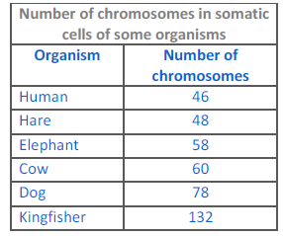
Chromosome numbers
Look up your favorite animal
Does chromosome number relate
To intelligence?

Slide 15
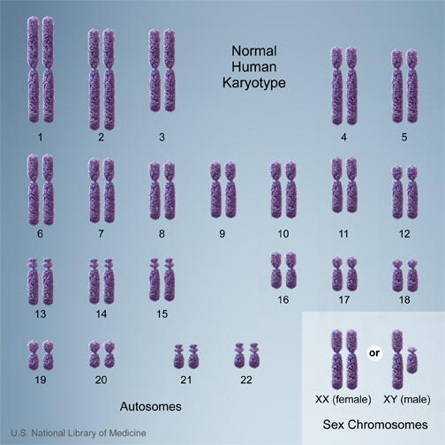
Types of Chromosomes
Autosomes V sex chromosomes

Slide 16
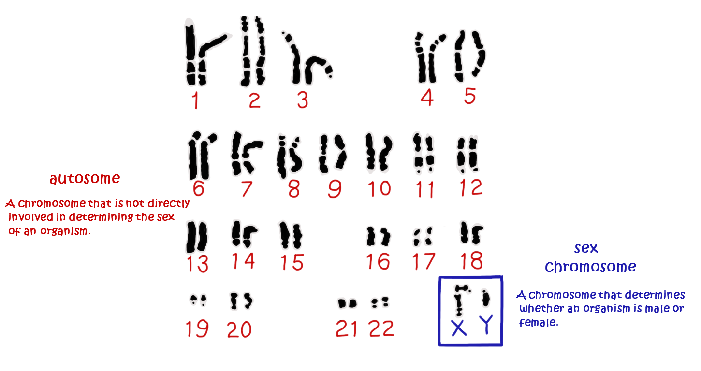

Slide 17
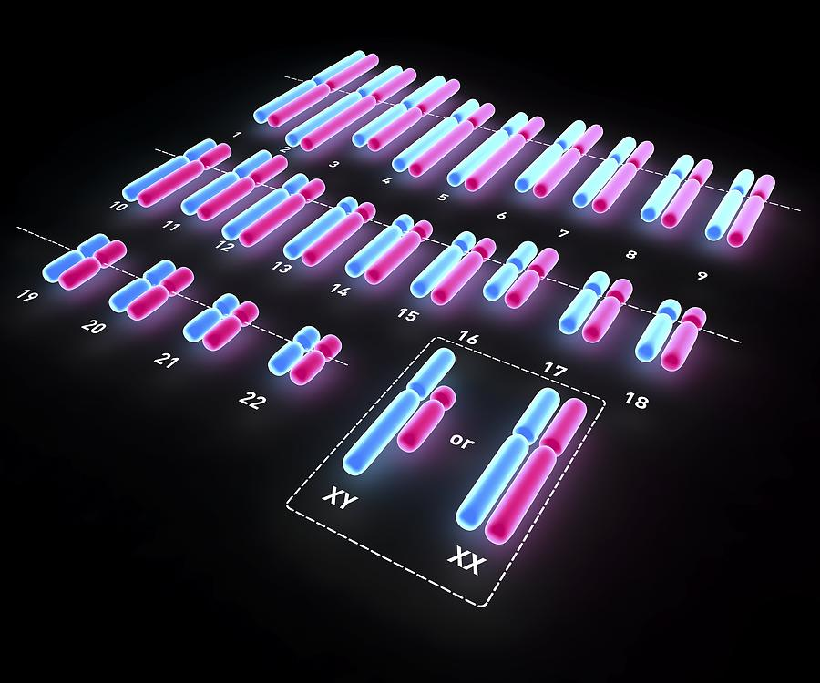
Male V Female

Slide 18
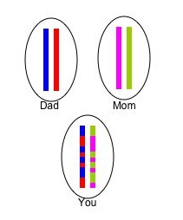
Homologous chromosomes
Autosome from mom + autosome from dad
Same size and shape
Carry same genes

Slide 19
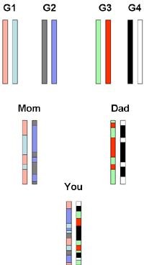

Slide 20
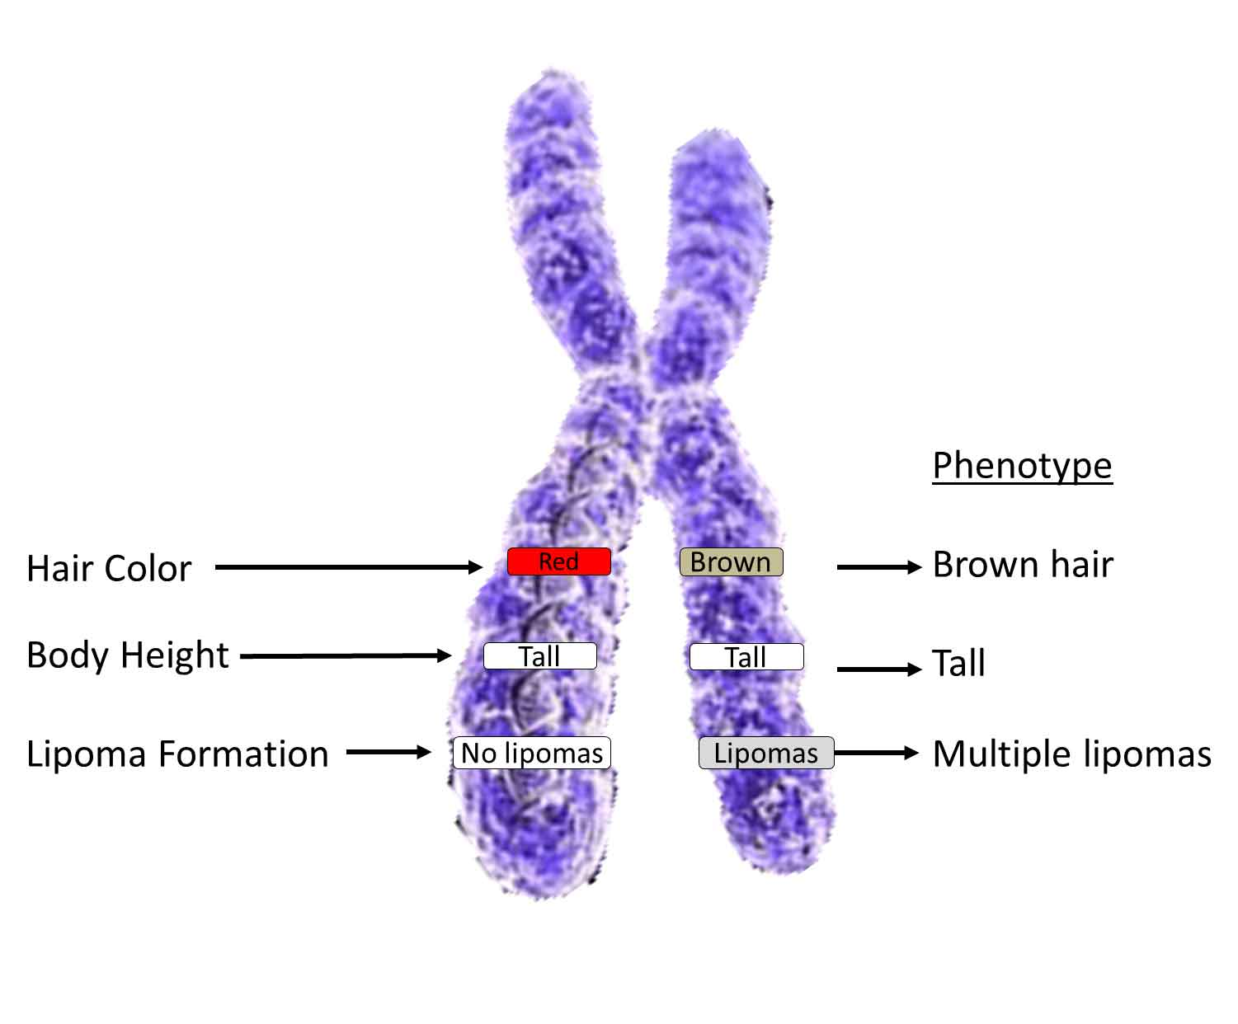
Phenotype

Slide 21
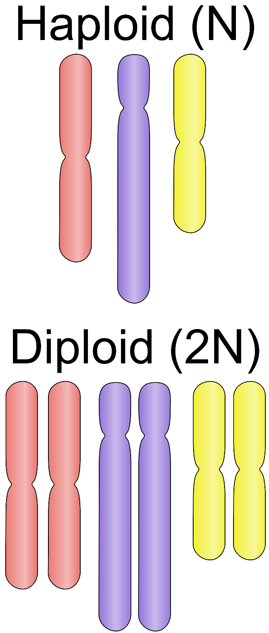
Review:
Haploid V Diploid
Why?!

Slide 22
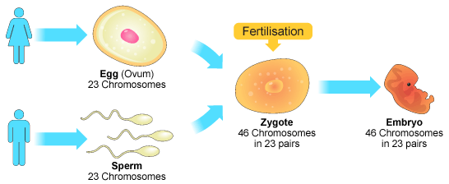
Why?
Haploid: half the genetic material; gametes (sex cells);
Why?!: later combine to form diploid cell
Diploid: entire set of chromosomes

Slide 23
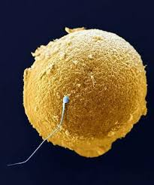

Slide 24
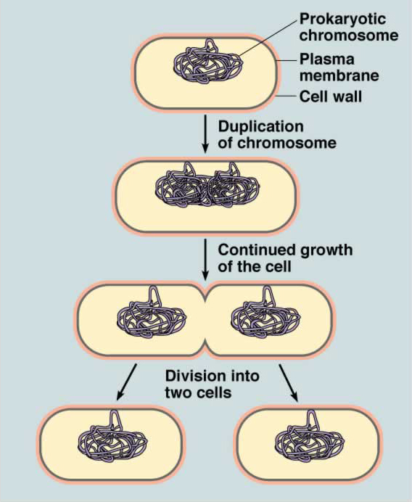
Cell Division- Prokaryotes
Binary Fission
http://www.youtube.com/watch?v=gEwzDydciWc

Slide 25
RAFTS
Role: Hosting a booth at a science conference
Audience: High school Bio students
Form: Technology and/or poster, model, quiz questions, handout
Topic: Mitosis, Cell Cycle, Meiosis
Strong Verb: Create

Slide 26
The Cell Cycle and Mitosis V Meiosis: Learning Station
Create a booth/learning station with your table mates concerning The Cell Cycle and Mitosis V Meiosis
Need to Know-The Cell Cycle:
5 phases and characteristics of each
Be able to logically link each stage
Discuss how cell division is controlled and what happens when control is lost
Include one current event article; google “uncontrolled cell division latest research”
Need to Know-Mitosis V Meiosis:
Type of cells involved
Purpose-sexual, asexual, genetic variation (Independent Assortment and Crossing Over)
Individual steps in a chronological order
Clever way to remember how to
You must include: 5-7 minute presentation
Model that you make or 3D print
Informational Poster, PowerPoint, Prezi, or website page
Audience Interaction and/or handout
5-10 HOTS questions

Slide 27
Class Rubric Ex:
Category | Points Available | Points earned
Effective Lesson/Person Knew Material | 10
Organized | 5
Cell Cycle Explanation | 5
Interesting Current Event | 5
Mitosis Explanation | 10
Meiosis Explanation | 10
Audience Interaction | 5
Quality Questions | 5
Creative | 5
Total | 60

